Slide 1
Using Ogre and Bullet
Wroclaw University of technology

Slide 2
Introduction
Using Ogre
Using Bullet
Combine

Slide 3
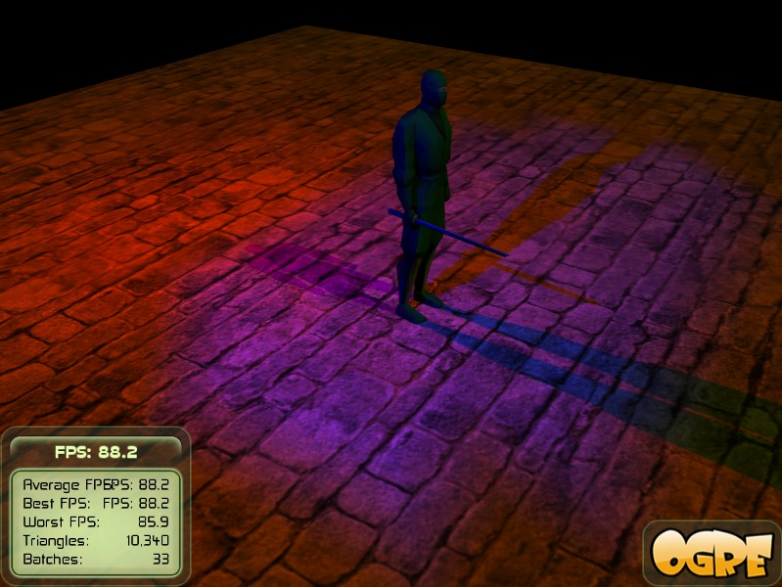
Using Ogre(1)
How is Ogre build
Entity (.mesh files)
SceneNodes
Lights
Viewports
Camera’s
Frame listener
Input

Slide 4
Using Ogre(2)
What to decide
Defining graphics
Defining camera position(‘s) and control
Usage of vieuwports
Input rate and transfer protocol
Usage of resources
How to handle settings
How to split up the program in multiple layers

Slide 5
Using Ogre(3)
What to make
Creating or combining grapics (.mesh files)
Generate program layers (Base layer, Base graphics, input handeling, Bullet calculations, etc. )

Slide 6
Bullet(1)
How is Bullet build
Library with a lot of functions to calculate physical functions
Separte functions to calculate

Slide 7
Bullet(2)
What to decide
Which functions are needed
What to combine with the input and what with the rest of the program
How to split up in multiple parts and layers

Slide 8
Combine
Combining Bullet and Ogre
Make a good overview of different tasks and layers
Make clear which functions are going to used and where
How to handle with delay and multiple threads
How to split up the program in solid and stable parts

